Slide 1
Project malignant comments classifier
Problem statement:The proliferation of social media enables people to express their opinions widely online. However, at the same time, this has resulted in the emergence of conflict and hate, making online environments uninviting for users. Although researchers have found that hate is a problem across multiple platforms, there is a lack of models for online hate detection.
Online hate, described as abusive language, aggression, cyberbullying, hatefulness and many others has been identified as a major threat on online social media platforms. Social media platforms are the most prominent grounds for such toxic behaviour.

Slide 2
Data set description:
The data set contains the training set, which has approximately 1,59,000 samples and the test set which contains nearly 1,53,000 samples. All the data samples contain 8 fields which includes ‘Id’, ‘Comments’, ‘Malignant’, ‘Highly malignant’, ‘Rude’, ‘Threat’, ‘Abuse’ and ‘Loathe’.
The label can be either 0 or 1, where 0 denotes a NO while 1 denotes a YES. There are various comments which have multiple labels.

Slide 3
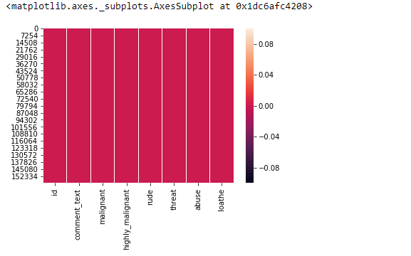
Data Visualiazation

Slide 4
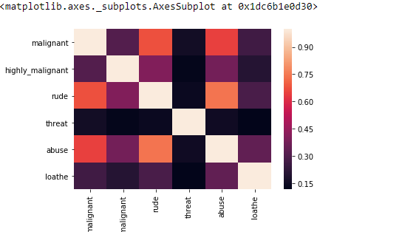
HEATMAP
Heatmap showing that there is no null values in the dataset.

Slide 5
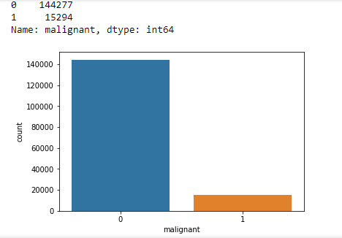
CountPlot on dataset columns
It is showing train and test of dataset.

Slide 6
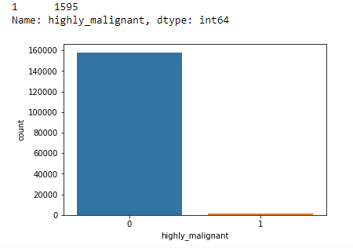
Countplot on highly-malignant dataset column.

Slide 7
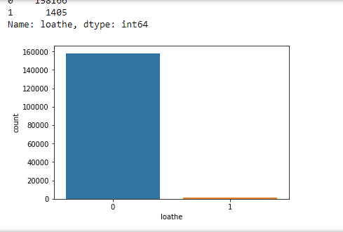
Countplot on loathe.

Slide 8
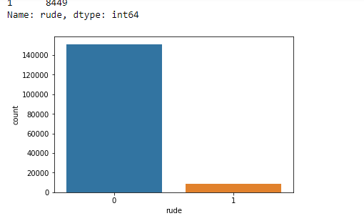
countPlot on rude comments.

Slide 9
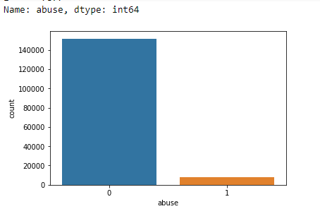
Countplot on Abuse column

Slide 10
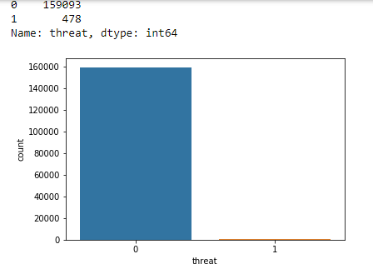
Countplot on threat column

Slide 11
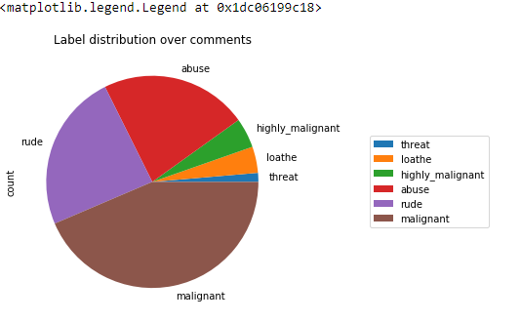
Label distribution over comments pie chart.

Slide 12
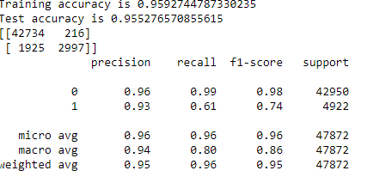
Model Evalution on Training and Testing set simultaneously.
First model LOGISTIC REGRESSION:

Slide 13
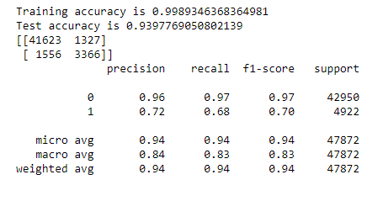
Decision Tree Accuracy on Train and Test data set.

Slide 14
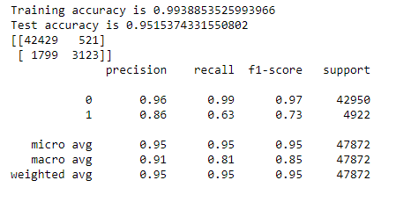
Random Forest Classifier Accuracy on Train and Test set.

Slide 15
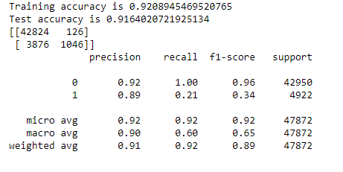
Kneighbours Classifier Accuarcy on Train and test Set.

Slide 16
Conclusion
Random forest classifier is the best model and we have got best accuracy on this model.

